Slide 3
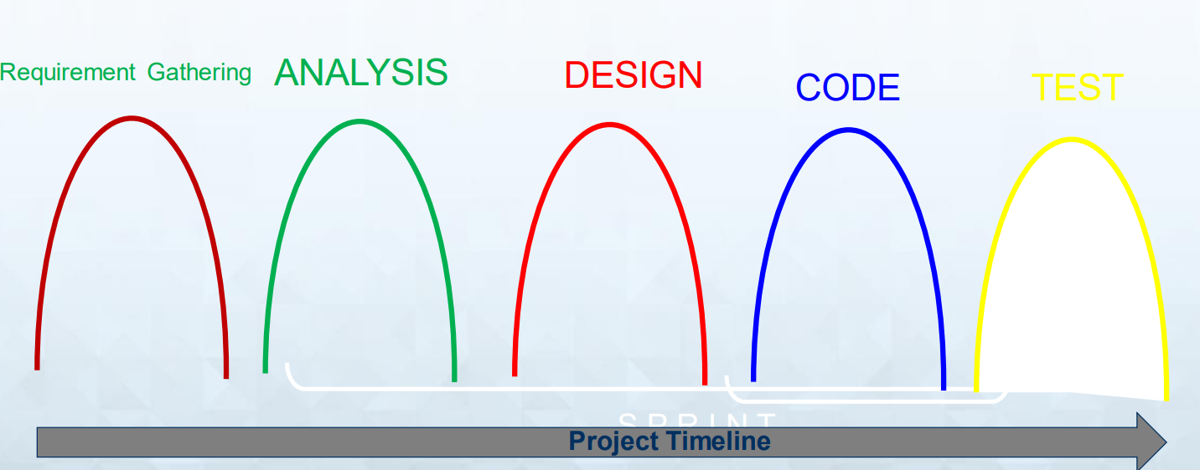
Not a good way

Slide 4
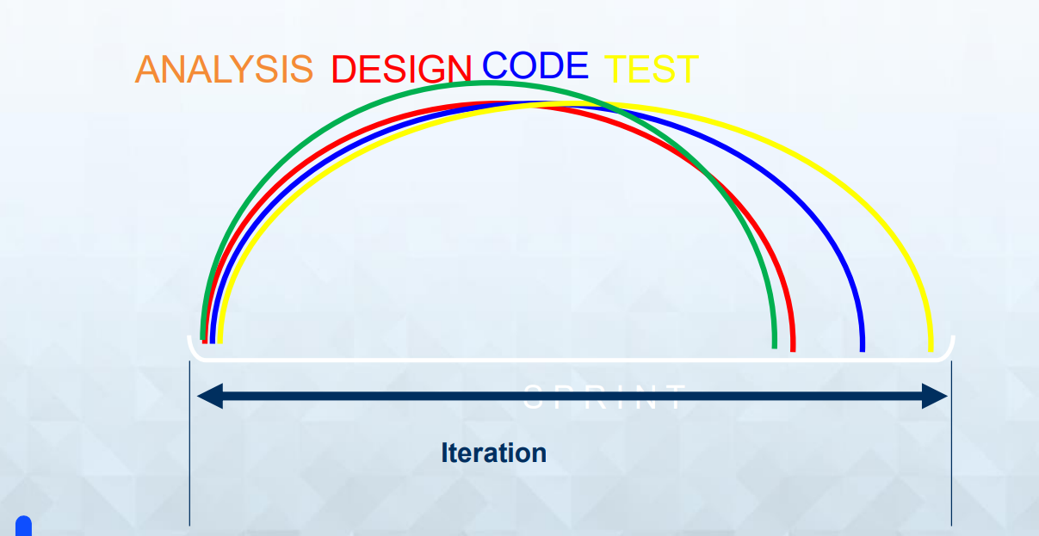
Good way

Slide 5
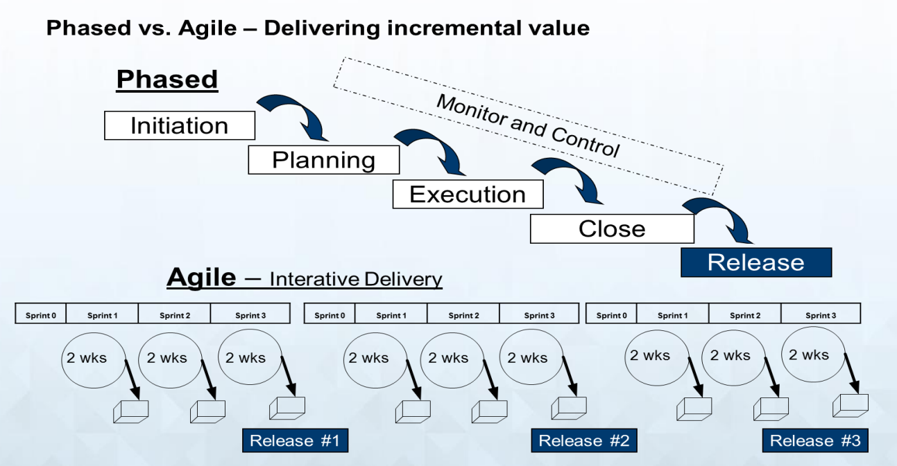

Slide 6


Slide 7
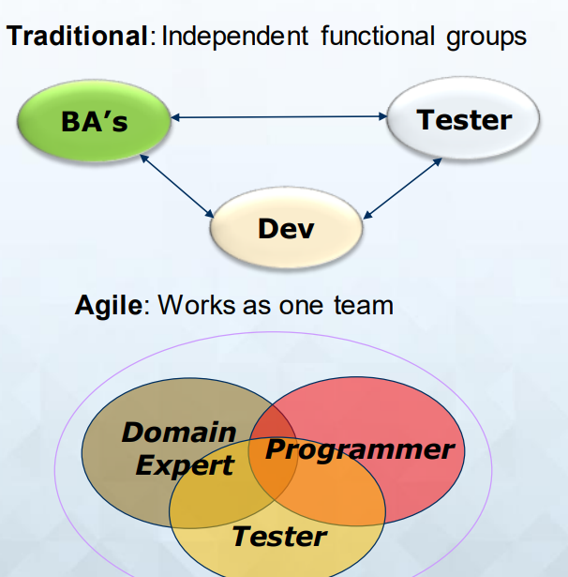

Slide 8
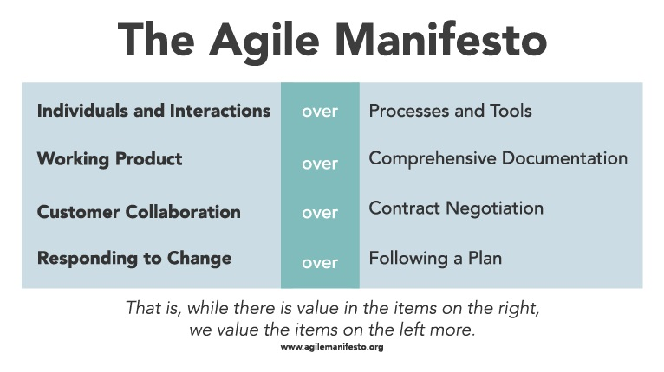

Slide 9
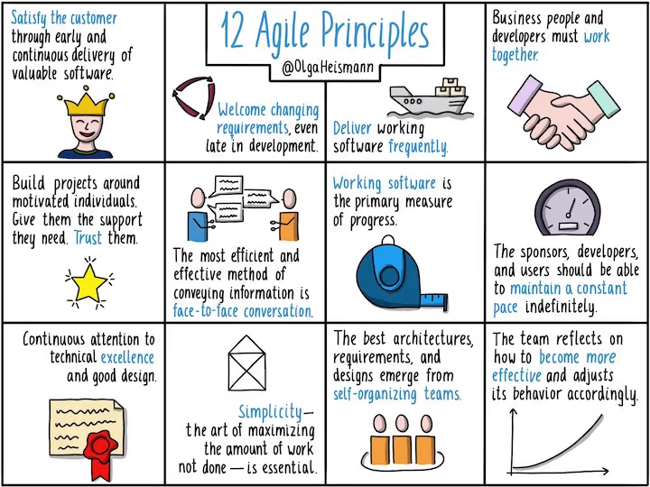

Slide 10
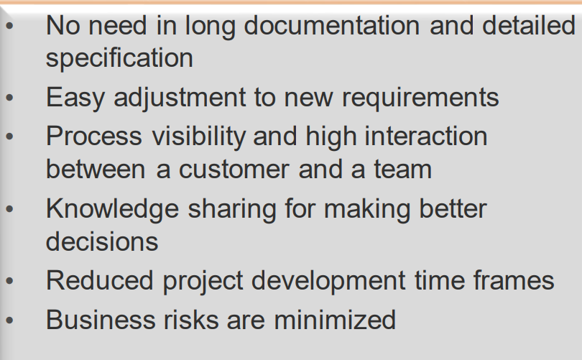
Agile advantage

Slide 12
What is Scrum? ... Scrum helps people and teams deliver value incrementally in a collaborative manner.
GOAL:
Manage Complexity, Unpredictability and Change through Visibility, Inspection and Adaptation

Slide 13
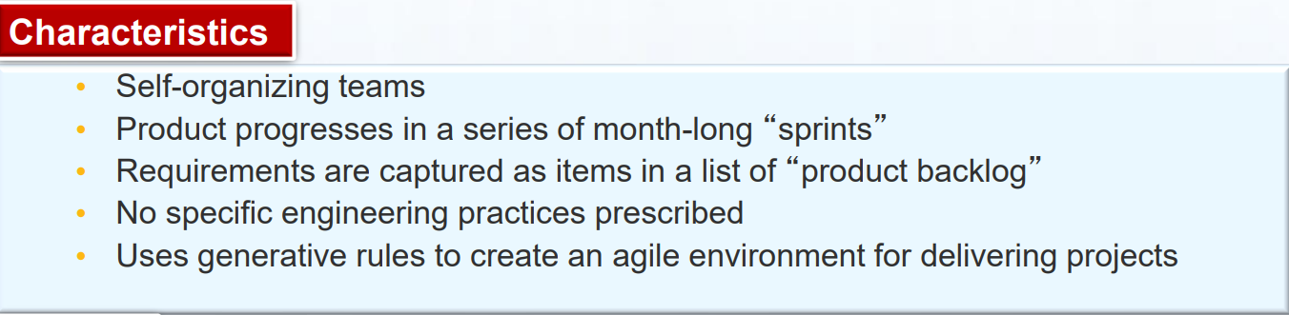
Scrum Characteristics & Values

Slide 14
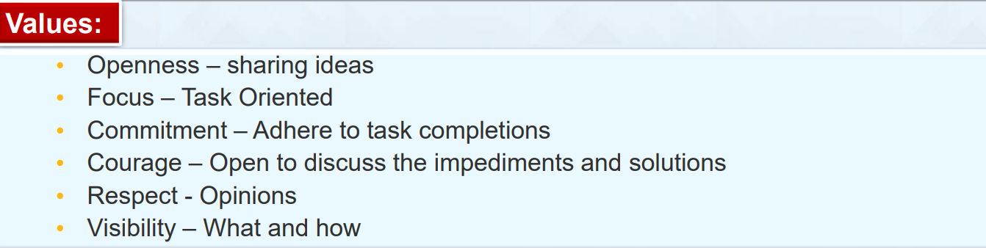

Slide 15
Sprint
During the sprint, the team must not be interrupted with additional requests. Guaranteeing the team won't be interrupted allows it to make real commitments it can be expected to keep.
Product is designed, coded and tested during the sprint
At the end of the sprint we have a sprint review meeting, followed by a sprint retrospective meeting

Slide 16
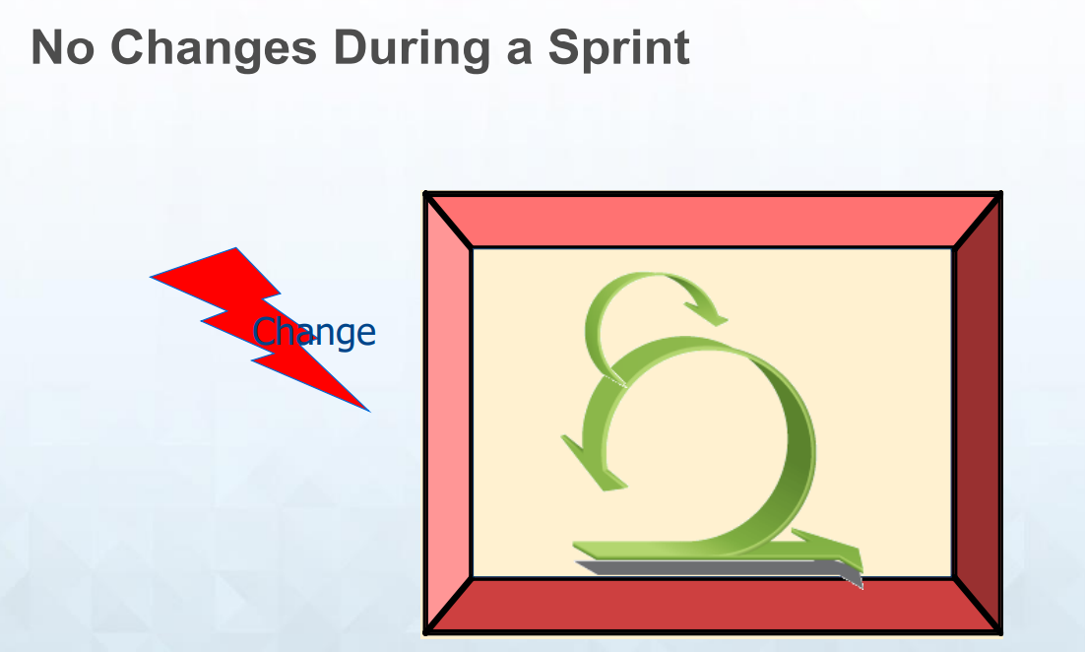

Slide 17
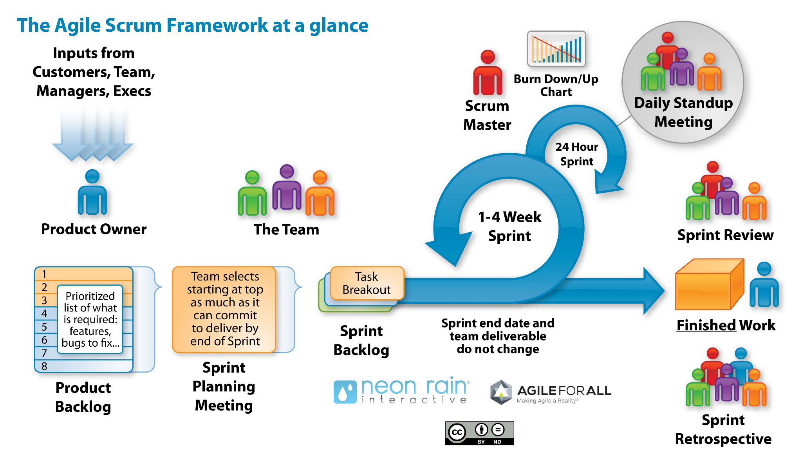
Creates prioritized wish list

Slide 18
The Sprint Review
Team presents what it accomplished during the sprint Typically takes the form of a demo of new features or underlying architecture Whole team participation

Slide 19
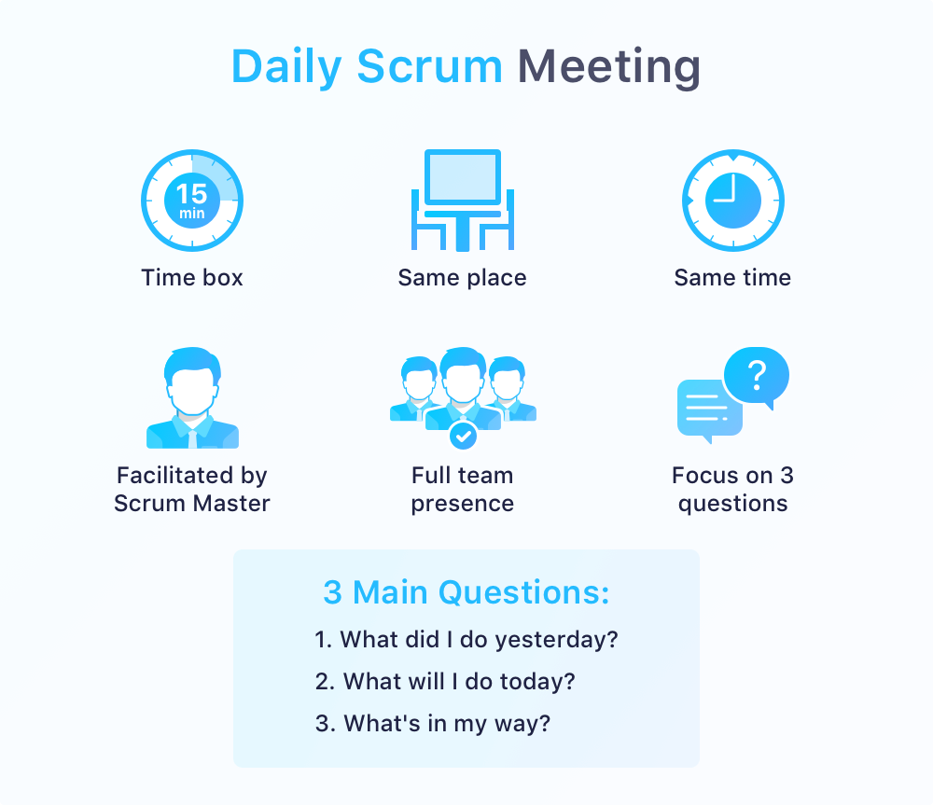

Slide 20
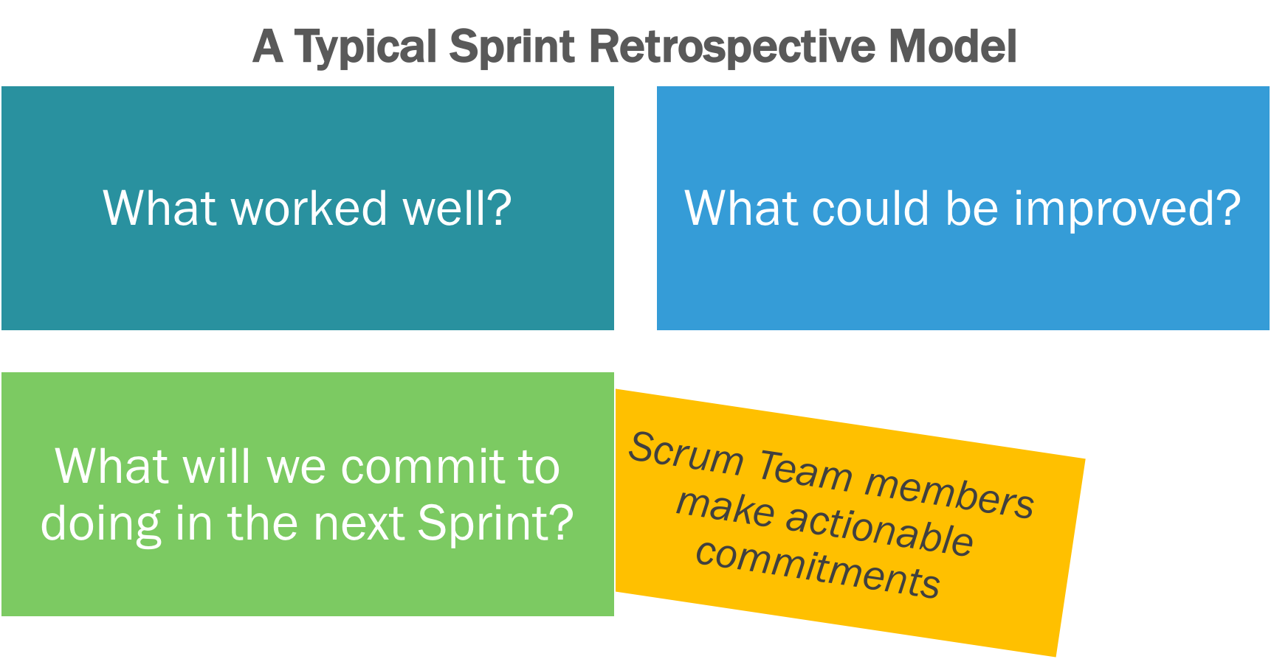
Retrospective meeting

Slide 21
Start / Stop / Continue
Start doing
Stop doing
Continue doing
This is just one of many ways to do a sprint retrospective.

Slide 22
Sprint Termination
Only in extreme cases Team terminates: cannot meet sprint goal Product Owner terminates: priority change Work reverted to end of prior sprint Raises visibility of problems

Slide 23
SCRUM CEREMONIES
•Sprint planning
•Sprint review
•Sprint retrospective
•Daily scrum meeting

Slide 24
SCRUM ROLE
•Product owner
•Scrum Master
•Team

Slide 25
ARTIFACTS
•Product backlog
•Sprint backlog
•Burndown charts

Slide 26
Product Backlog
Prepared by Product Owner
• List of customer requirements prioritized by business value
• The Scrum Team contributes to the product backlog by estimating the cost of developing features.
• Should include all features visible to the customer, as well as the technical requirements needed to build the product
• The highest priority items in the Product Backlog need to be broken down into small enough chunks to be estimable and testable
• About ten developer -days of work is a good size for a Product Backlog item that can be ready for implementation in the next iteration

Slide 27
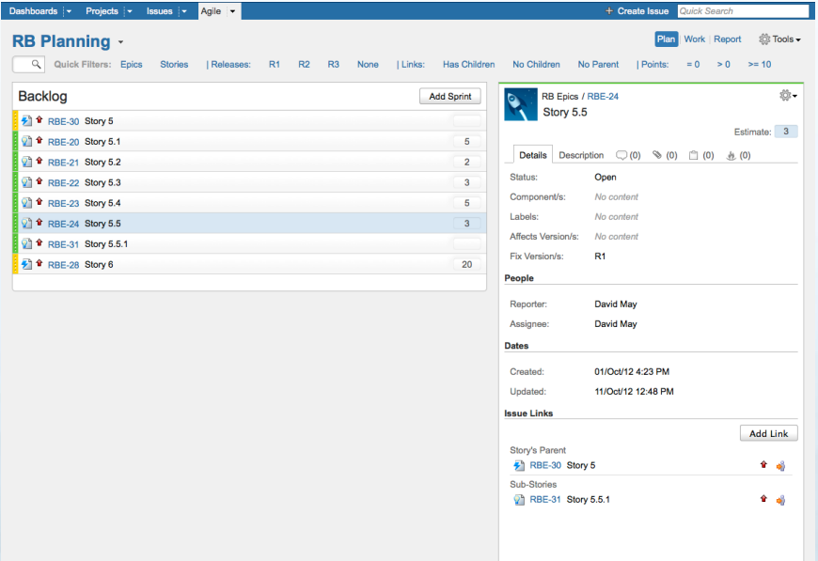

Slide 29
Sprint Backlog
an artifact of the Sprint Planning Meeting
• Scrum Team has selected and committed to deliver a set of top priority features from the Product Backlog, the Product Backlog's features are broken down into a Sprint Backlog
• a list of the specific development tasks required to implement a feature
• These tasks are broken down into pieces that will require less than two days (or sixteen developer -hours) of work.
When the Sprint Backlog is complete, the total work estimated is compared with original estimates from the Product Backlog. If there is a significant difference, the team negotiates with the Product Owner to get the right amount of work to take into the Sprint with a high probability of success

Slide 30
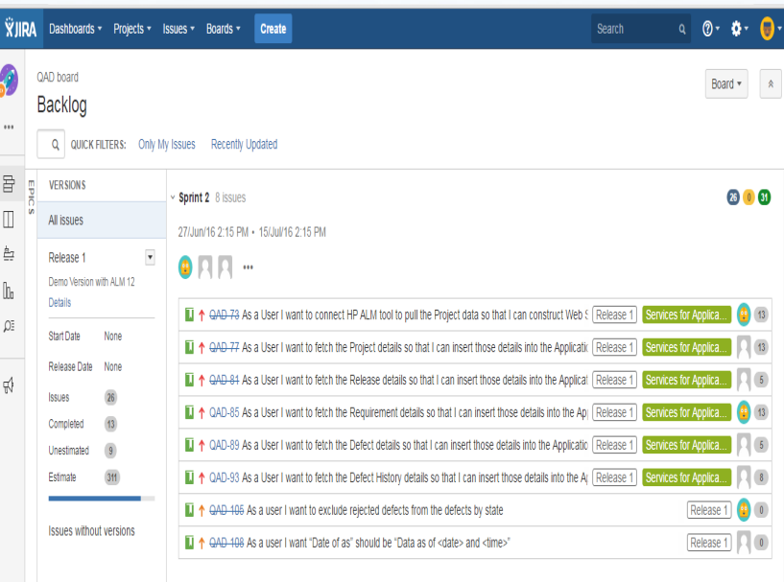

Slide 31
Burndown Chart
shows the cumulative work remaining in a Sprint, day-byday
• used as a tool to guide the development team to successful completion of a Sprint on time with working code that is potentially shippable as a product

Slide 32
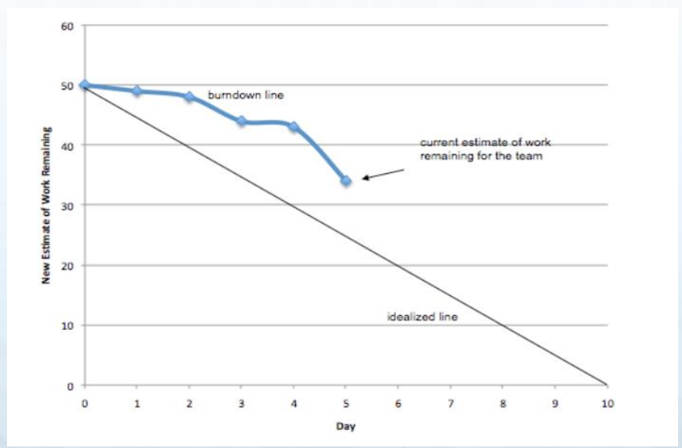

Slide 33
Doing Scrum
• Choose a reference
• Estimate size in relation to reference - but don’t tell anyone yet
• Show your cards at the same time
• Discuss differences
• Repeat estimation until consensus
• Estimated User Story becomes new reference

Slide 34
Planning Poker for Estimation

